Slide 1
Online Model Learning and Control from Streaming Data using Gaussian Processes for Robot Teleoperation
Presentation by Brian Wilcox
2nd Year PhD in Computer Eng, UCSD
B.S. in Mechanical Eng, MIT
PhD GEM Fellow, Intel Corporation

Slide 2
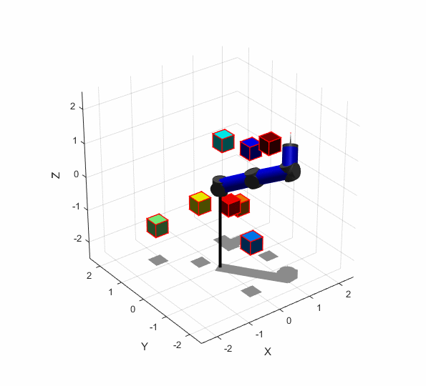
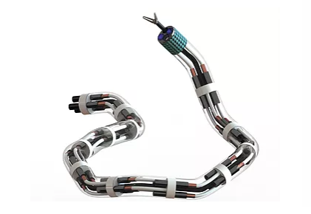
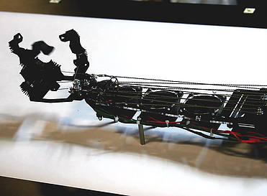
Motivation: UCSD ARCLab
Advanced Robotics and Control Laboratory at UC San Diego
https://www.ucsdarclab.com/

Slide 3
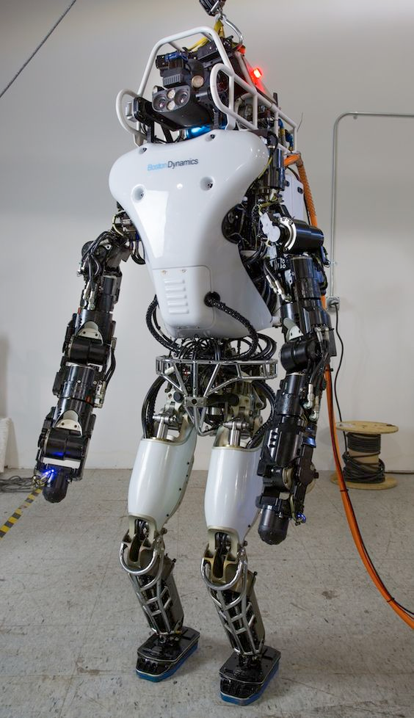
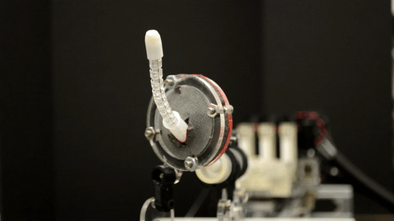

Motivation: Learning to Manipulate
Many complex robotic systems have:
Inaccurate or unknown system models
Unknown environment dynamics
Non-stationary behavior
Through machine learning, we can learn a model of very complex systems, however, there remain many challenges such as:
Large Training Time
Data Availability
Deterministic Models
Appropriate model selection

Slide 4
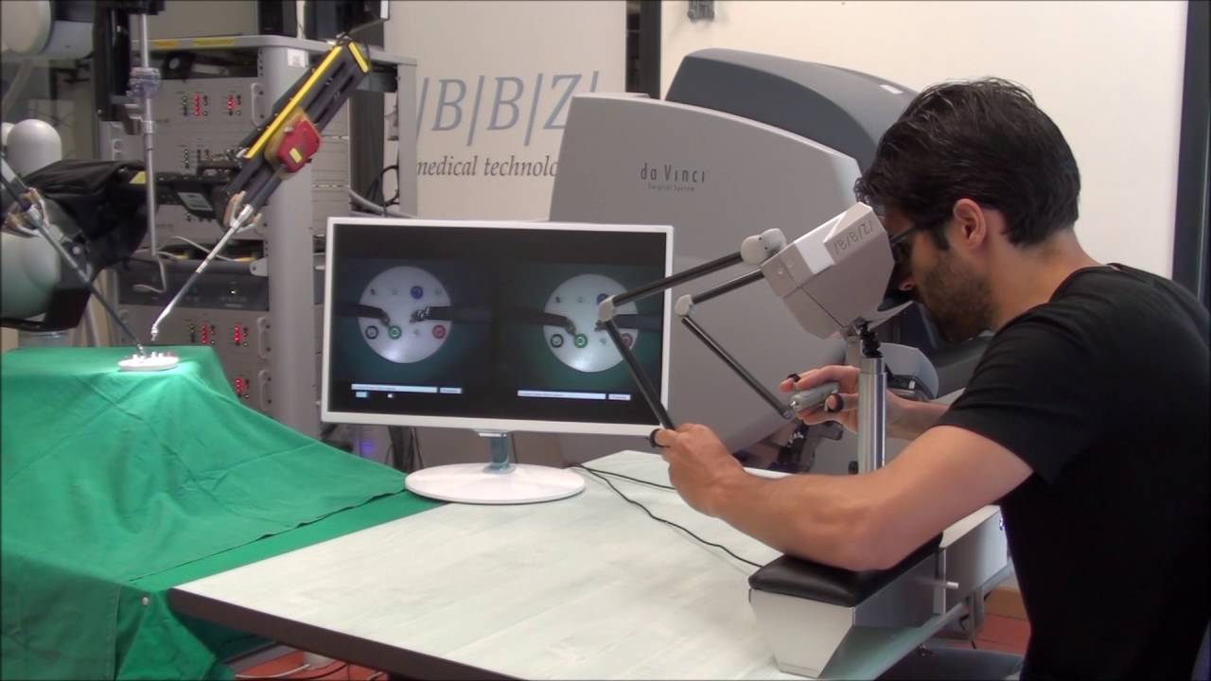
Motivation: Teleoperation
In teleoperation tasks, both sensor readings and motor commands come in streams of data
For a data-driven controller, the robot model (mapping from state to actuator) should be learned and adapt to these streams of data, while also making accurate predictions about the desired actuator inputs
In a nutshell, need a controller which is:
Robust
Adaptive
Real-Time
Data-efficient

Slide 5
My Research
Aim: Online model-learning and control for a teleoperation task
Plan: Sparse Online Local Gaussian Process Regression (SOLGPR) to infer a local function mapping of robot sensor states to joint states and perform a prediction of the teleoperation command for joint control.
Application: Teleoperation of remote robotic catheter for catheter ablation in minimally invasive surgery

Slide 6
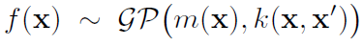
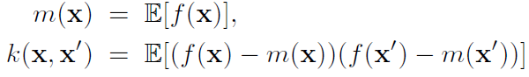
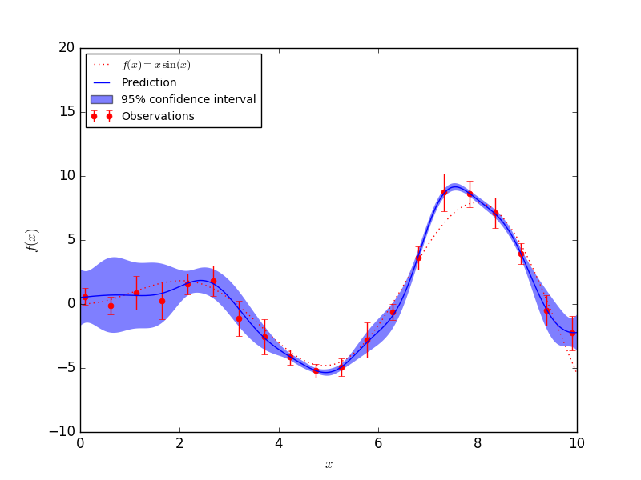
Methods: Sparse Online Local Gaussian Processes
Gaussian Process is a distribution over functions (Rasmussen & Williams ‘06)
GP is characterized by a mean function, m, and covariance function, k
In regression, we want to infer the function output for test inputs, f*
We learn by optimizing the hyperparameters of the covariance function

Slide 7
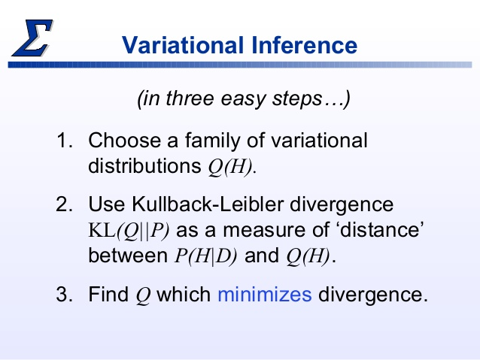
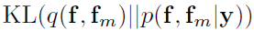
Methods: Sparse Online Local Gaussian Processes
Variational Inference for GP (Titsias ‘09) is a method to find the optimal M << N inducing points which will maximize the similarity between the induced posterior distribution and the full posterior distribution via the KL divergence
The computational complexity can be reduced from O(N^3) inversion operation to O(NM^2)
minimize

Slide 8
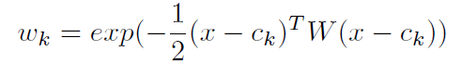
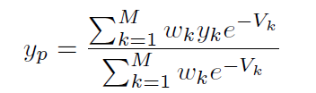
Methods: Sparse Online Local Gaussian Processes
A local model of the robot system should allow for adaptive behaviors in the region of our workspace
In GP, can find K local models of our dataset, each with D local points (Nguyen-Tuong et al. ‘08)
For prediction, uses a modified* weighted prediction

Slide 9
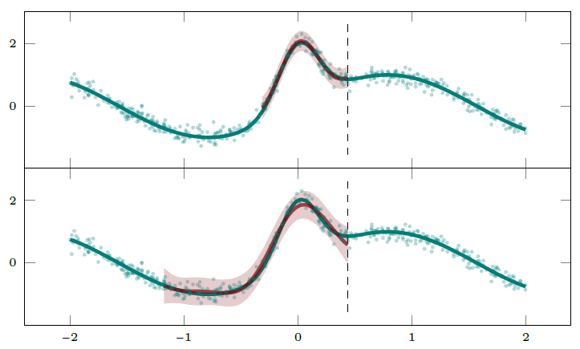
Methods: Sparse Online Local Gaussian Processes
For online, we want to deal with minibatches or an incremental update
In addition to local models and sparsity, we use a Drifting Gaussian Process to speed up performance for online:
“Drifting” minibatches of data, where older/non-rich data points deleted as new data added (Meier & Schaal ‘16)
An optimization of the model is performed after a set interval
Increases adaptability to sudden changes

Slide 10
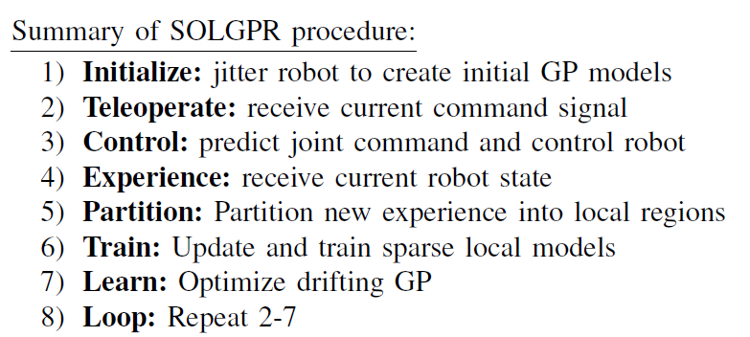
The Algorithm Summary

Slide 11
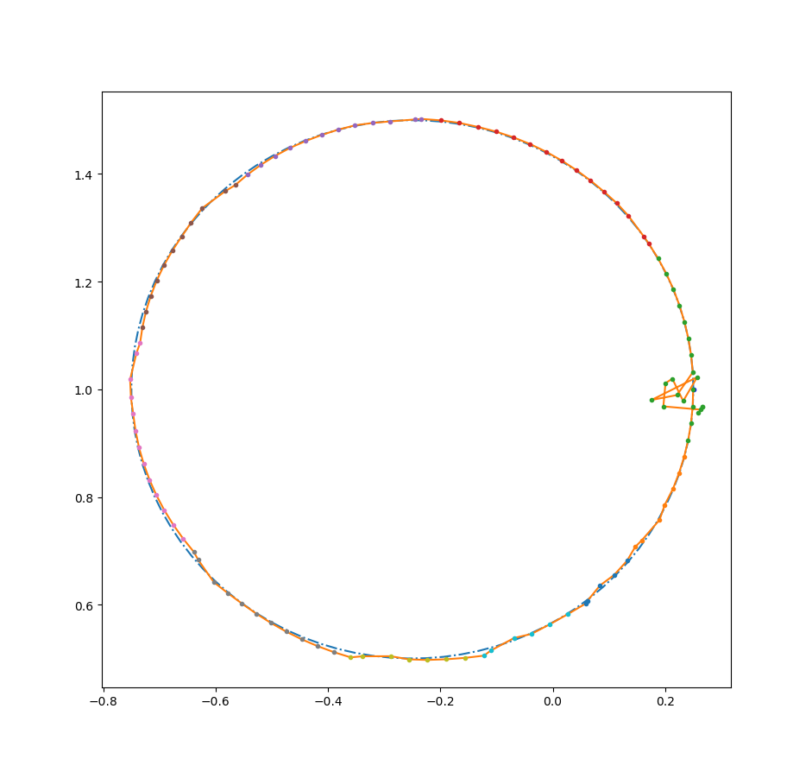
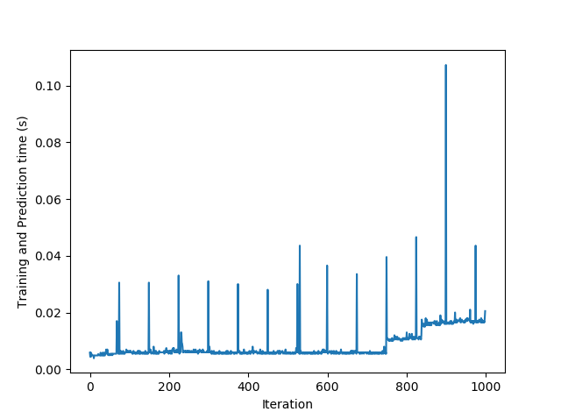
Results: Initial Test
Control of two-link arm on circular trajectory

Slide 12
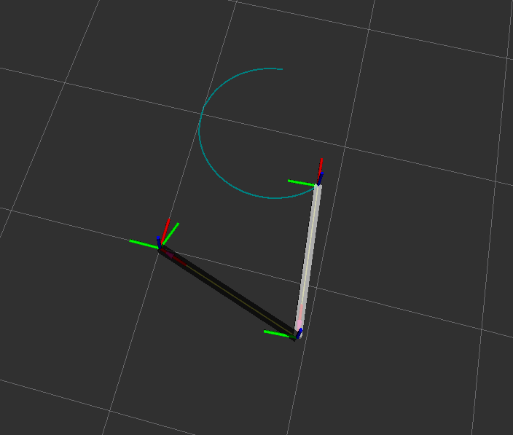
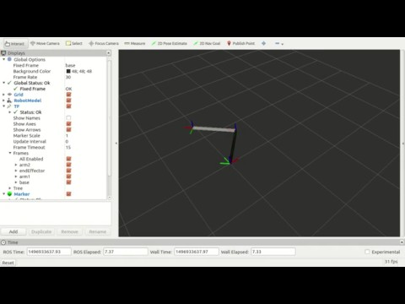
Results: ROS
Robot Operating System (ROS) implementation of teleoperation

Slide 13
Looking Ahead
Tune parameters for increased accuracy and adaptability
Faster, faster, faster : take advantage of +1 data point incremental updates
Optimize tradeoff of computational complexity and performance
Incorporate algorithm into model-based reinforcement learning
THANK YOU. QUESTIONS?

